Slide 1
Debugging
GCC 4.1.2 STL Implementation

Slide 2
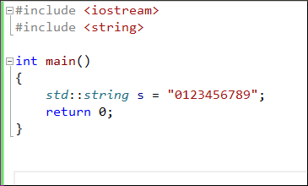
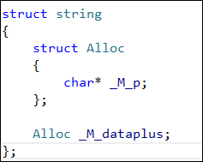
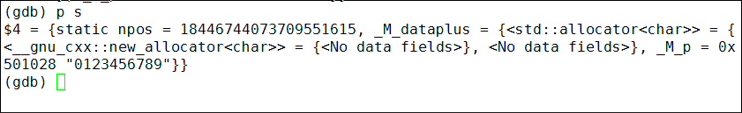

gcc 4.1.2 STL Internals —— STRING
(gdb) set print pretty on

Slide 3
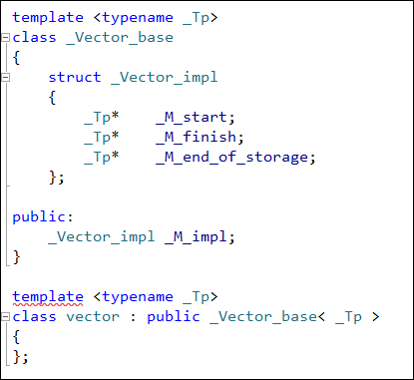
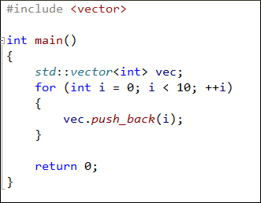
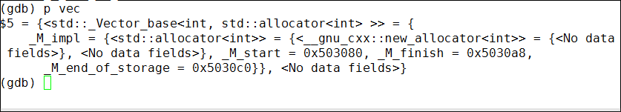
gcc 4.1.2 STL Internals —— vector
_M_end_of_stroage
p (int [10])*vec._M_impl._M_start
p *vec._M_impl._M_start@10
0
1
2
^
_M_start
_M_finish

Slide 4
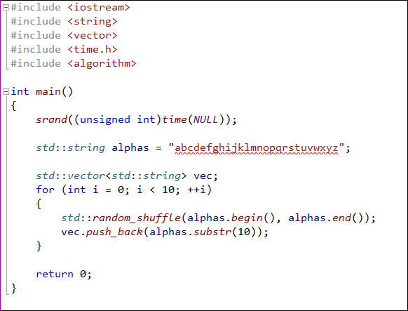
练习
用x命令观察随机生成的字符串

Slide 5
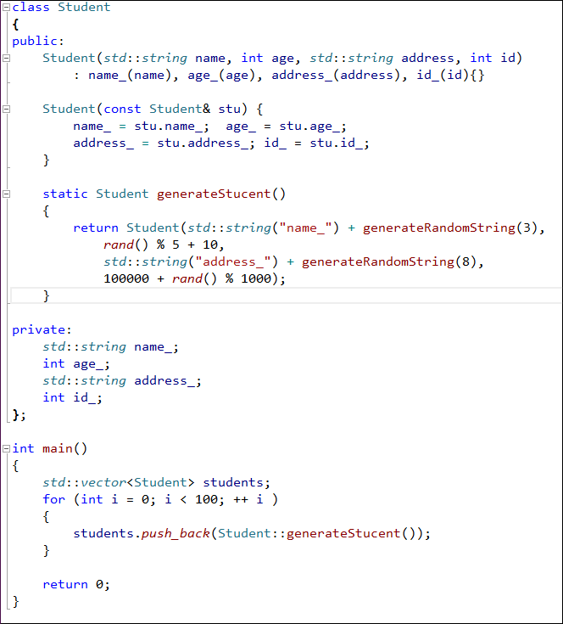
练习
找出第33个学生的信息

Slide 6
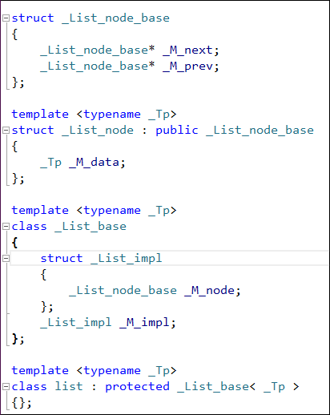
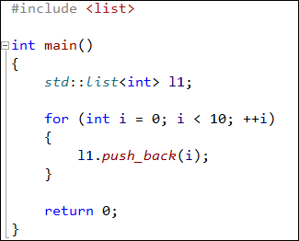
gcc 4.1.2 STL Internals —— LIST
_M_impl
_M_next
_M_prev
_M_next
_M_next
_M_next
_M_prev
_M_prev
_M_prev
_M_data
_M_data
_M_data

Slide 7
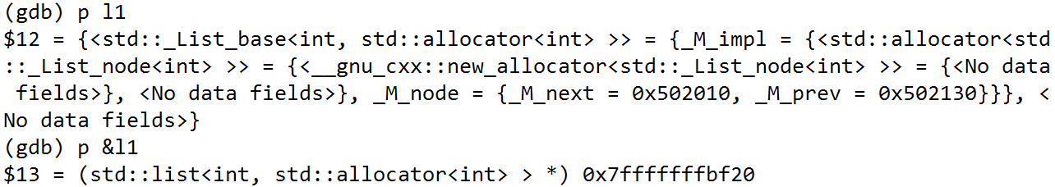
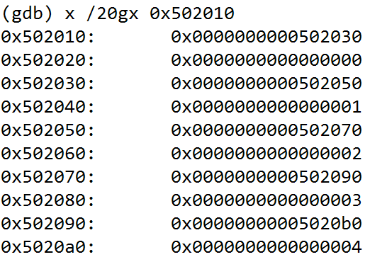
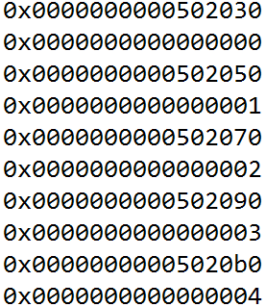
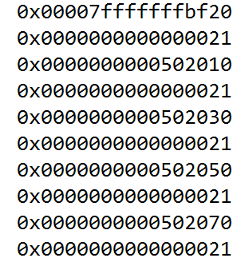
gcc 4.1.2 STL Internals —— LIST
_M_impl
_M_next
_M_prev
_M_next
_M_next
_M_next
_M_prev
_M_prev
_M_prev
_M_data
_M_data
_M_data

Slide 8
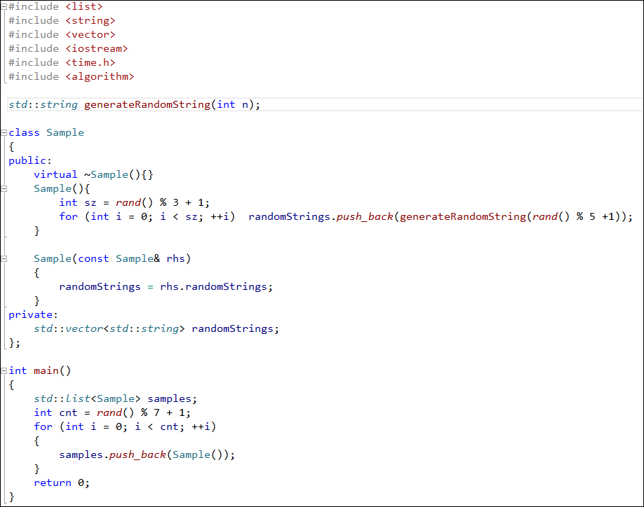
练习
给出samples中的全部信息

Slide 9
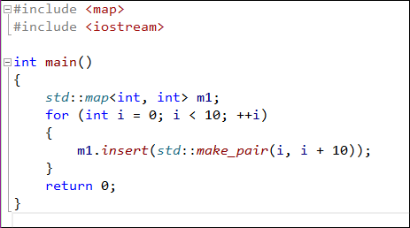
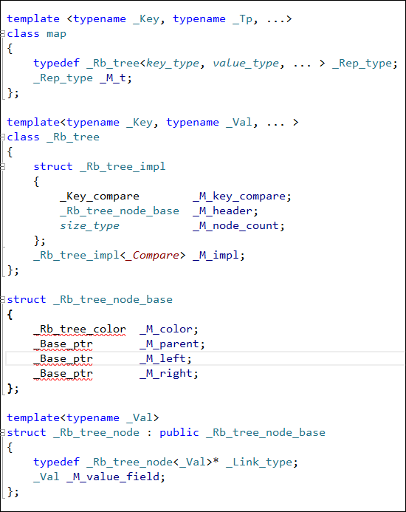
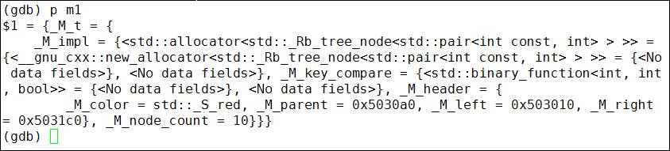
gcc 4.1.2 STL Internals —— MAP

Slide 10
gcc 4.1.2 STL Internals —— MAP
_M_key_compare
_M_color
Root
_M_parent
_M_color
_M_left
_M_parent
_M_right
_M_left
key(2)
_M_right
value(12)
_M_node_count
Max
Min
_M_color
_M_color
_M_parent
_M_parent
_M_left
_M_left
_M_color
_M_right
_M_right
_M_color
_M_parent
key(1)
key(3)
_M_parent
_M_left
value(11)
value(13)
_M_left
_M_right
_M_right
key(0)
key(4)
value(10)
value(14)

Slide 11
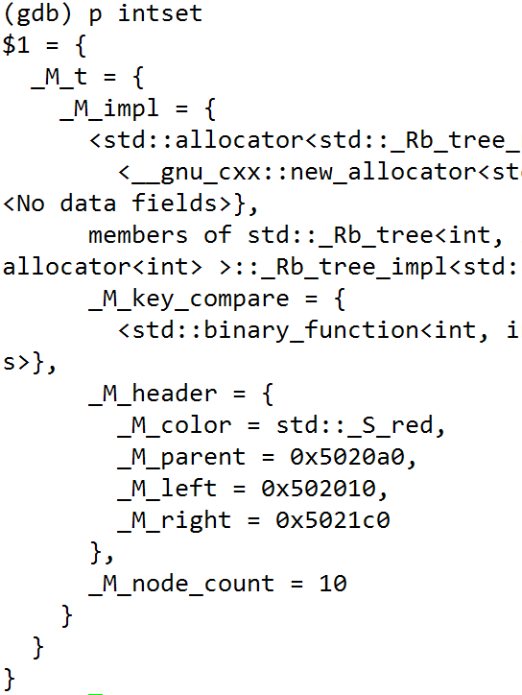
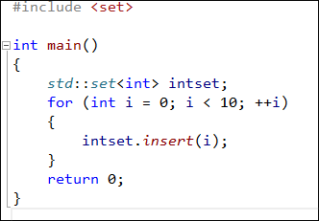
gcc 4.1.2 STL Internals —— SET
_M_color
_M_parent
_M_left
_M_right
key
value

Slide 12
gcc 4.1.2 STL Internals —— Set
_M_key_compare
_M_color
Root
_M_parent
_M_color
_M_left
_M_parent
_M_right
_M_left
key(2)
_M_right
_M_node_count
Max
Min
_M_color
_M_color
_M_parent
_M_parent
_M_left
_M_left
_M_color
_M_right
_M_right
_M_color
_M_parent
key(1)
key(3)
_M_parent
_M_left
_M_left
_M_right
_M_right
key(0)
key(4)

Slide 13
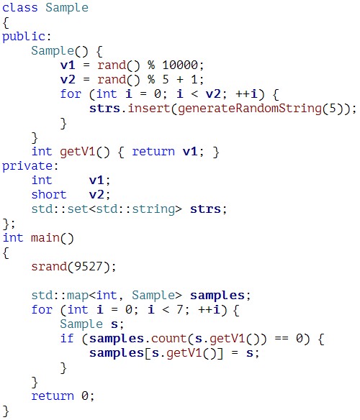
练习
调试map中的内容

Slide 14
练习
找一个产品代码中的类进行调试

Slide 15
Q & A

Slide 16
Thank You
For questions or suggestions:
Liu Jie
jieliu@thoughtworks.com

